Slide 1
The Association of Community College Trustees
The Voice of Community College Trustees

Slide 2
Advocates on behalf of community colleges
Influences public policy
Educates trustees
Facilitates student success
Places college presidents & other executives
Conducts original research

Slide 3
Our Members…
Accredited, non-profit 2-year colleges
12 million students
1,200 institutions
6,500 trustees

Slide 4
Strategic Priorities

Slide 5
GOAL ONE
Advance student success and completion strategies.

Slide 6
GOAL TWO
Prepare trustees for the evolution of the community college.

Slide 7
Services

Slide 8
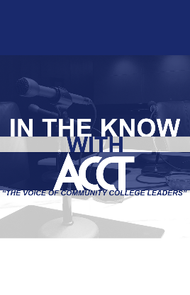
Trustee Education News & Information
Trustee Quarterly magazine
In the Know with ACCT podcast
Trustee Talk
Governance guides
Online policy templates, toolkits, research reports & other resources

Slide 9
Trustee Education Events
ACCT Leadership Congress
Governance Leadership Institute

Slide 10
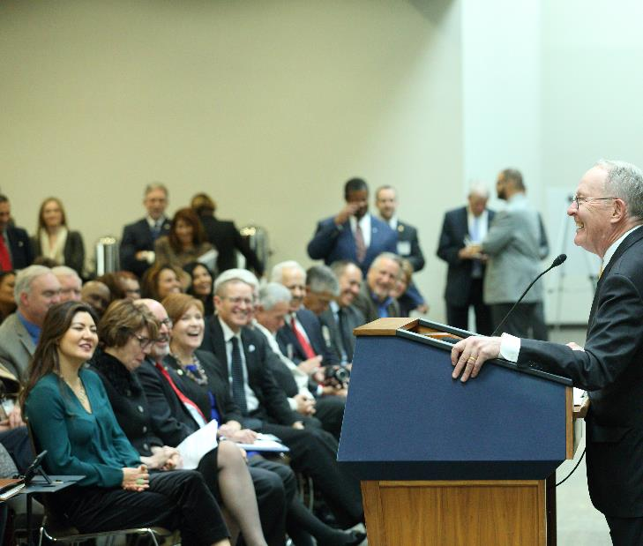
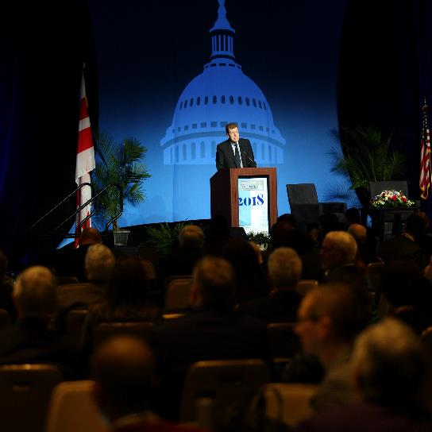
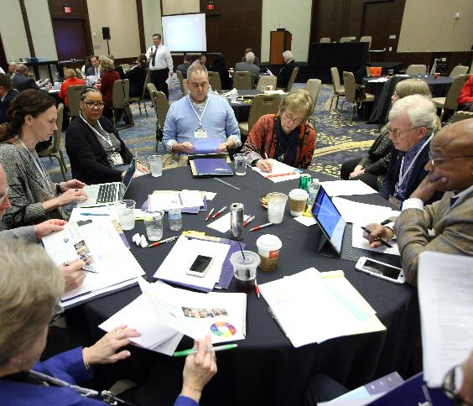
Advocacy
Community College National Legislative Summit
Printed & online policy templates, toolkits, research reports & other resources

Slide 11
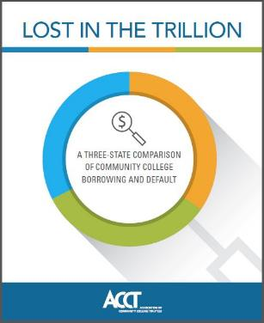
Research
Apprenticeships
Food & housing insecurity
Mental health
Nontraditional students
Rural college needs
Student debt
Student success
Workforce solutions
…and more

Slide 12
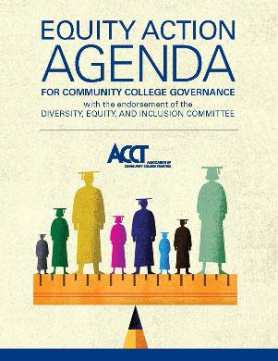
Policy Resources Boardroom Discussion Guides
Student Success—Policy Action Agenda
Equity Action Agenda

Slide 13
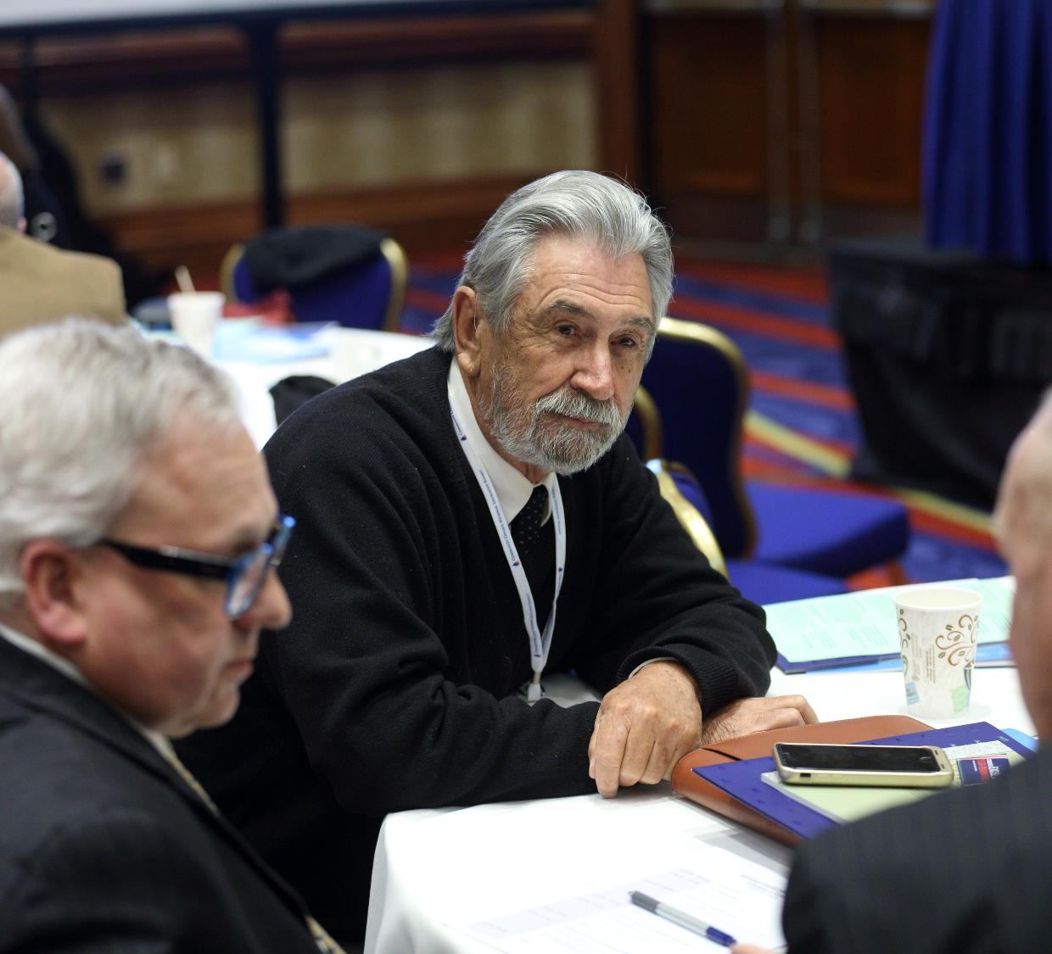
Strategic Board Services
Board retreats and workshops
Board self-assessments
Executive searches & transitions
Policy review
Presidential/executive evaluations
Succession planning

Slide 14
How Can ACCT Help Your College?
Board Education
Networking
Federal-level Advocacy
Tailored Community College Board Service Interventions
Meeting Communities’ Needs

Slide 15
Emerging Needs

Slide 16
What Do Community Colleges Need To Serve Their Students & the Community?
Sustainable resource and business models.
Renewing public investment and public trust.
Increased student enrollments.
Educational and workforce relevance.

Slide 17
What Do Community College Trustees Need To Serve Their Students & the Community?
Understanding the special fiduciary responsibilities of boards
Understanding strong board-CEO relationships = strong institutions
Effective advocacy = secured public funding
Adapting institution & curricula to meet emerging needs
Community engagement = increased enrollment and persistence.

Slide 18
The voice of community college leaders.
Contact Us
Email:
Phone:
Website:
acctinfo@acct.org
202-775-4667
www.acct.org

